Slide 1

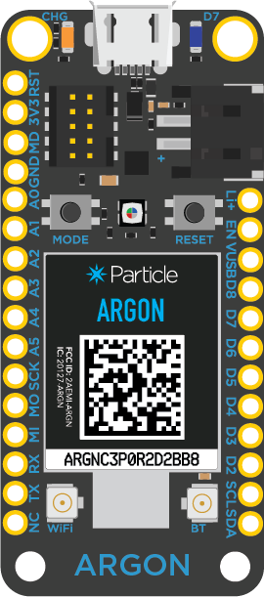
Argon uses Particle.subscribe() to subscribe to event iotIsAwesome…
Argon
Particle Cloud

Slide 2
Argon uses Particle.subscribe() to subscribe to event iotIsAwesome…
and creates awesomeHandler() function to called automatically when event happens in the future
Argon
Particle Cloud

Slide 3
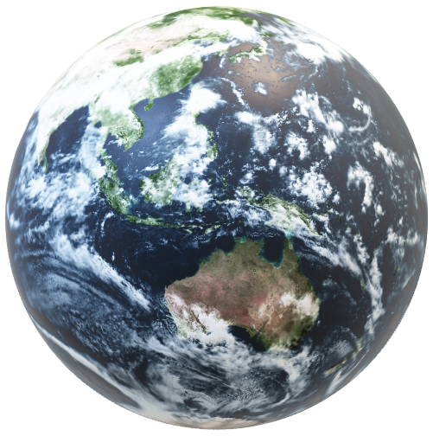
A device publishes an event to Particle Cloud
iotIsAwesome event
Any Device (including Argon)
Argon
Particle Cloud

Slide 4
Particle Cloud will notify any subscribers
A device publishes an event to Particle Cloud
iotIsAwesome subscriber notification
iotIsAwesome event
Any Device (including Argon)
Argon
Particle Cloud

Slide 5
Particle Cloud will notify any subscribers
A device publishes an event to Particle Cloud
iotIsAwesome subscriber notification
iotIsAwesome event
awesomeHandler() unction to called automatically when event happens in the future
Any Device (including Argon)
Argon
Particle Cloud

